Slide 1
DIVIDE and CONQUER

Slide 2
Divide and Conquer
Divide and conquer is used for data parallelism
The same operation is done on all parts of the data (add, sort, min/max)
Some parts of the data can be eliminated (binary search)
Complexity of divide and conquer
T(n)= Constant (time for smallest subproblem)
T(n)= aT(n/b)+D(n)+C(n)
Each subproblem divided into 1/b the portion
D(n): Time to divide
C(n): Time to combine
Can be solved by Master’s Theorem in most cases

Slide 3
Some Examples
Given a set of integers
Find the sum
Find the minimum
Find whether a number exists
Find n!
Matrix Multiplication
Find the most frequently occurring number
Divide and Conquer can be applied to any associative operation (add, multiply, etc.) on a series of numbers
Often the complexity is not changed
However, we can apply parallelism to improve the speed

Slide 4
Computing the Factorial
Find n!
Divide the numbers into k processors
Compute sequential products on elements in each processor
Multiply the results from each processor
With p processors and n entries
Multiplication: n/p
Combining log(p)
Total n/p+log(p)
With sequential= n
3*4
5*6
7*8
1*2
5*..*8
1*..*4
8!

Slide 5
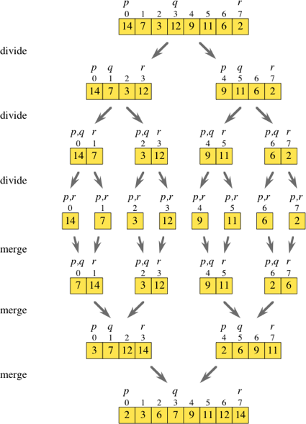

Slide 6
Complexity of Merge Sort
Dividing the array:
Constant time C1
We divide it in two equal size arrays that have to be processe
2T(n/2)
Combining two arrays each of size n
C2*2(n/2)=C2*n
Total Complexity: C1+2T(n/2)+C2*n
We can ignore C1 as it is less than the combining complexity of n
T(1)=1
T(n)= 2T(n/2)+C2*n

Slide 7
Quicksort
Quicksort is one of the fastest known sorting algorithm in practice.
Quicksort is a divide-and-conquer recursive algorithm.
Average running time O(N logN).
O(N²) worst-case performance, but this can be made exponentially unlikely with a little effort.

Slide 8
Quicksort Algorithm
quicksort( S ):
If the number of elements in S is 0 or 1, then return.
Pick any element v in S. This is called the pivot.
Partition S-{v} (the remaining elements in S) into two disjoint groups: S₁={x∈S-{v}|x≤v}, and S₂={x ∈S-{v}|x≥v}.
Return {quicksort(S₁) followed by v followed by quicksort(S₂)}.

Slide 9
Quicksort
13
81
31
57
43
75
0
92
65
26
select pivot
13
81
31
57
43
75
0
92
65
26
partition
0
26
65
13
31
92
75
57
43
81

Slide 10
Quicksort
0
26
65
Recursively sorting the set of smaller numbers
13
31
92
75
57
43
81
quicksort small
quicksort largel
0
13
26
31
43
57
65
75
81
92
Merge
0
13
26
31
43
57
65
75
81
92

Slide 11
Why is it faster than mergesort?
It is clear that this algorithm works but it is not clear why it is faster than mergesort.
Like mergesort, it recursively solves two subproblems and requires linear additional work.
Unlike mergesort, the subproblems are not guaranteed to be of equal size. (potentially bad)
Picking a good pivot makes the partitions well balanced
The main reason: the partitioning step can be performed in place and very efficiently. This efficiency more than makes up for the lack of equal-sized recursive calls.
However for small arrays insertion sort works better

Slide 12
Picking Pivot: median-of-three
8 1 4 9 5 3 7 2 6 0
Left
Center
Right
Pivot is 5
0 1 2 3 4 5 6 7 8 9
Left
Center
Right
Using median-of-three partitioning eliminates
the bad case for sorted input.

Slide 13
Picking Pivot: median-of-three
8 1 4 9 5 3 7 2 6 0
pivot
0 1 4 9 5 3 7 2 6 8
Swap 5 and 6
0 1 4 9 6 3 7 2 5 8
i
j
pivot
We are now ready for partitioning

Slide 14
Partitioning Strategy
Move all the small element to the left part of the array and all the large elements to the right part.
Place pivot at position right-1;
Set i = left and j =right-2;
Repeat until i < j
If a[ i ] < pivot, i++
Move i right, skipping over elements that are smaller than the pivot.
If a[ j ] > pivot, j--
Move j left, skipping over elements that are large than the pivot.
Swap a[ i ] with a[ j ].
Finally, Swap the pivot element with the element pointer to by i.

Slide 15
Partitioning
0 1 4 9 6 3 7 2 5 8
i
j
pivot
Swap 9 and 2
0 1 4 2 6 3 7 9 5 8
i
j
pivot
Swap 6 and 3
0 1 4 2 3 6 7 9 5 8
j
pivot
i
At this state, i and j have crossed, so no swap is performed.

Slide 16
Partitioning Strategy
0 1 4 2 3 6 7 9 5 8
Finally, swap a[ i ] with pivot
i
pivot
j
0 1 4 2 3 5 7 9 6 8

Slide 17
Analysis of Quicksort
The running time of quick sort is equal to the running time of the two recursive calls plus the linear time spent in the partition (the pivot selection takes only constant time)
T(0) = T(1) = 1
T(N) = T(i) + T(N – i – 1) + N (time for partitioning) where i=|S₁| is the number of elements in S₁.

Slide 18
Best Case Analysis
Best Case: the pivot is always in the middle; i = n/2
T(1)=1, T(0)=1 T(N)=T(N/2)+T(N/2)+O(N)
Pivot operation
Right recursion
Left recursion
Looks familiar?

Slide 19
Worst-Case Analysis
Worst-case: the pivot is the smallest element all the time; i = 0;
T(0) = T(1) = 1
T(N) = T(0) + T(N – 1) + O(N)
Pivot operation
N-1 recursion
0 recursion

Slide 20
MAXIMUM SUBARRAY SUM
1. Divide A[low...high] into two subarrays of as equal size as possible by finding the midpoint mid
2. Conquer: (a) finding maximum subarrays of A[low...mid] and A[mid + 1...high] (b) finding a max-subarray that crosses the midpoint
3. Combine: returning the max of the three
Given an array of numbers that contains both positive and negative values, find the sum of the continuous subarray which has the largest sum.
{-2, -5, 6, -2, -3, 1, 5, -6} = maximum subset sum is 7
Complexity=2T(n/2)+n+1

Slide 21
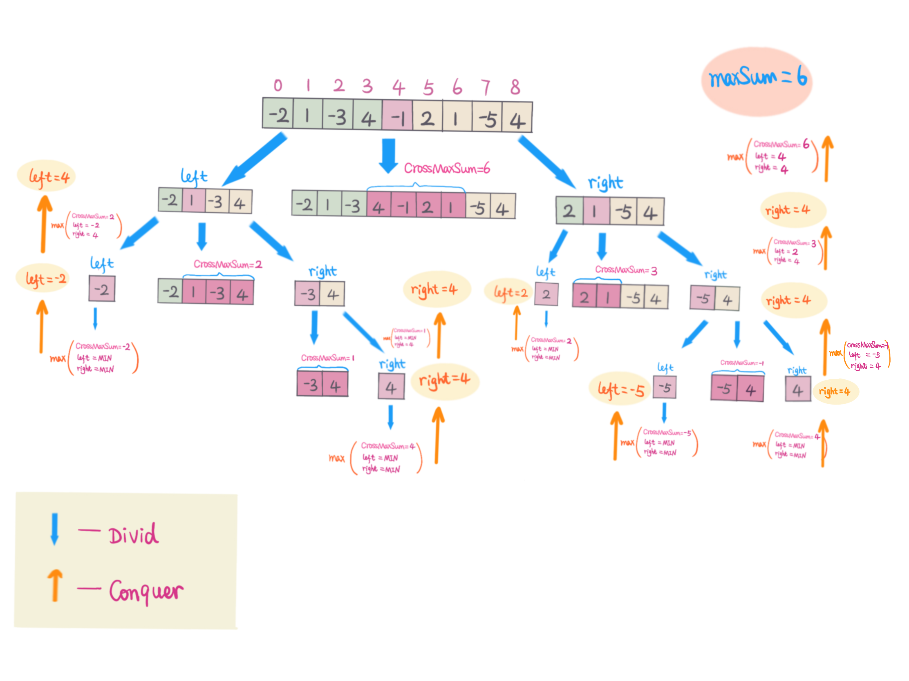
Image from: https://snowan.gitbook.io/study-notes/leetcode-33/english-solution/53.maximum-sum-subarray-en

Slide 22
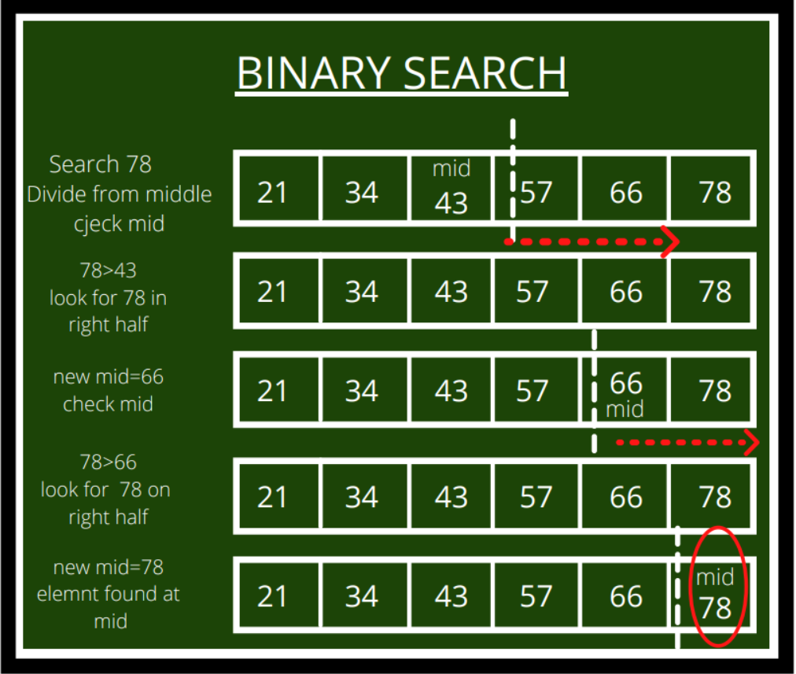
BINARY SEARCH
Find whether a target number exists in a sorted array
Divide array into 2; get the middle number
If target > middle number recursively check the right half
Otherwise check the left half
Stop when number if found
Complexity: 2T(n/2)+1

Slide 23
Finding the MINIMUM in A Circularly Sorted ARRAY
Sorted array
{2,4,7,8,10,11,15}
Circularly sorted means that we have rotated the array n times
First rotation
{15,2,4,7,8,10,11}
Second rotation
{11, 15,2,4,7,8,10}
Third rotation
{10, 11, 15,2,4,7,8}
Note the the minimum number is the only one whose predecessor and successor are higher than it.
Position of the minimum number also gives us the number of rotations done.

Slide 24
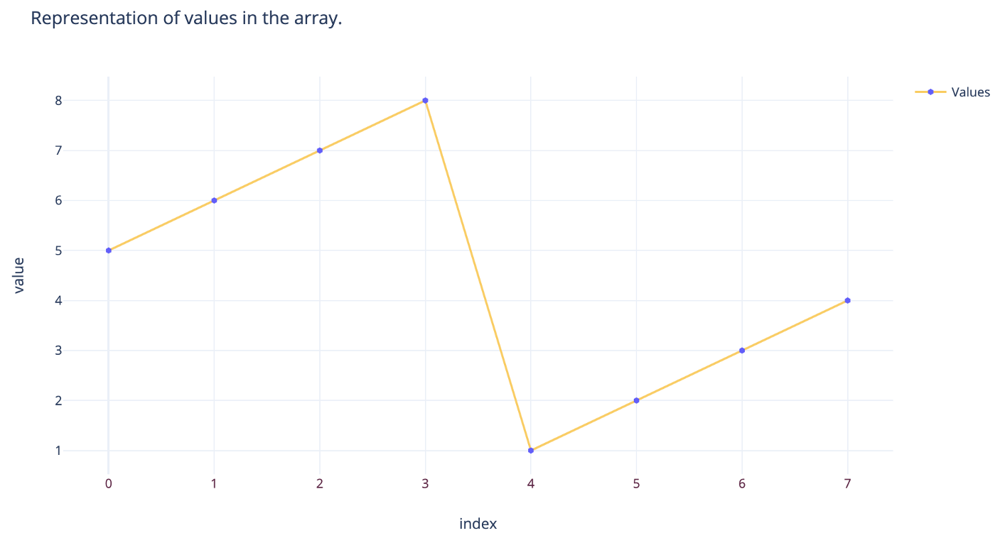
Finding the MINIMUM in A Circularly Sorted ARRAY
Check that the array is rotated, i.e. first element is not the minimum.
Find middle element in array A =>A[mid]
If A[mid-1] > A[mid] & A[mid+1]> A[mid]; then A[mid] is the minimum
If A[mid]> A[0]; recursively sort for A[mid to end]
Else A[mid]< A[0]; recursively sort for A[0 to mid ]

Slide 25
Karatsuba’s Algorithm
Multiplying two numbers
X=x1B^{m} + x0; Y=y1B^{m} + y0;
Traditionally
X*Y= (x1B^{m} + x0)(y1B^{m} + y0)
=x1y1B^{2m}+(x1y0+y1x0) B^{m}+x0y0 => 4 multiplications
Complexity (for binary numbers)=4T(n/2)+n (length of number ≈ number of multiplications)
Karatsuba’s method
z2=x1y1; z1=x1y0+y0x1; z0=x0y0
Z1=(x1+x0)(y1+y0)-z2-z0 => only 3 multiplications needed
Complexity =3T(n/2)+n

